Slide 1
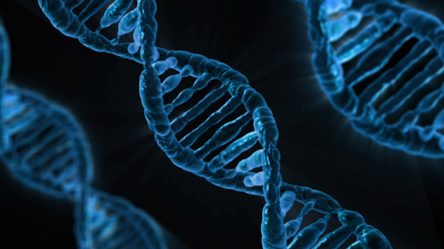



Deep learning for single-cell analysis
Yuan Tian
Staff Scientist
Fred Hutchinson Cancer Research Center
https://www.linkedin.com/in/ytianimmune
https://github.com/naity
https://twitter.com/_ytian_

Slide 2
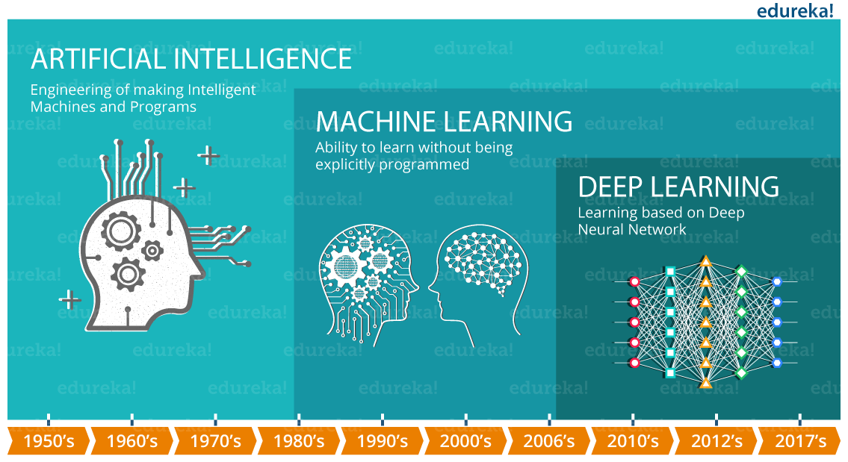
Deep learning is a subset of machine learning

Slide 3
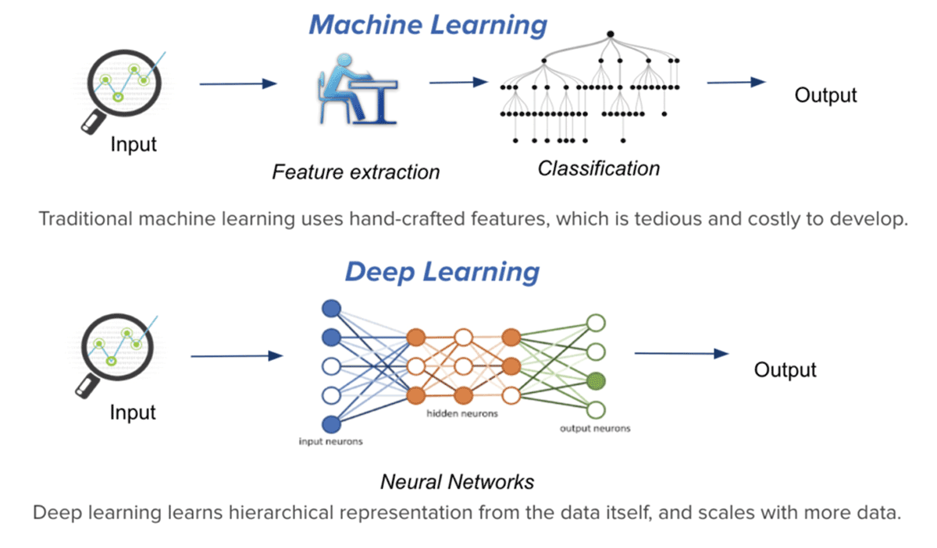
Deep learning requires less feature engineering than traditional machine learning
Image source: idm

Slide 4
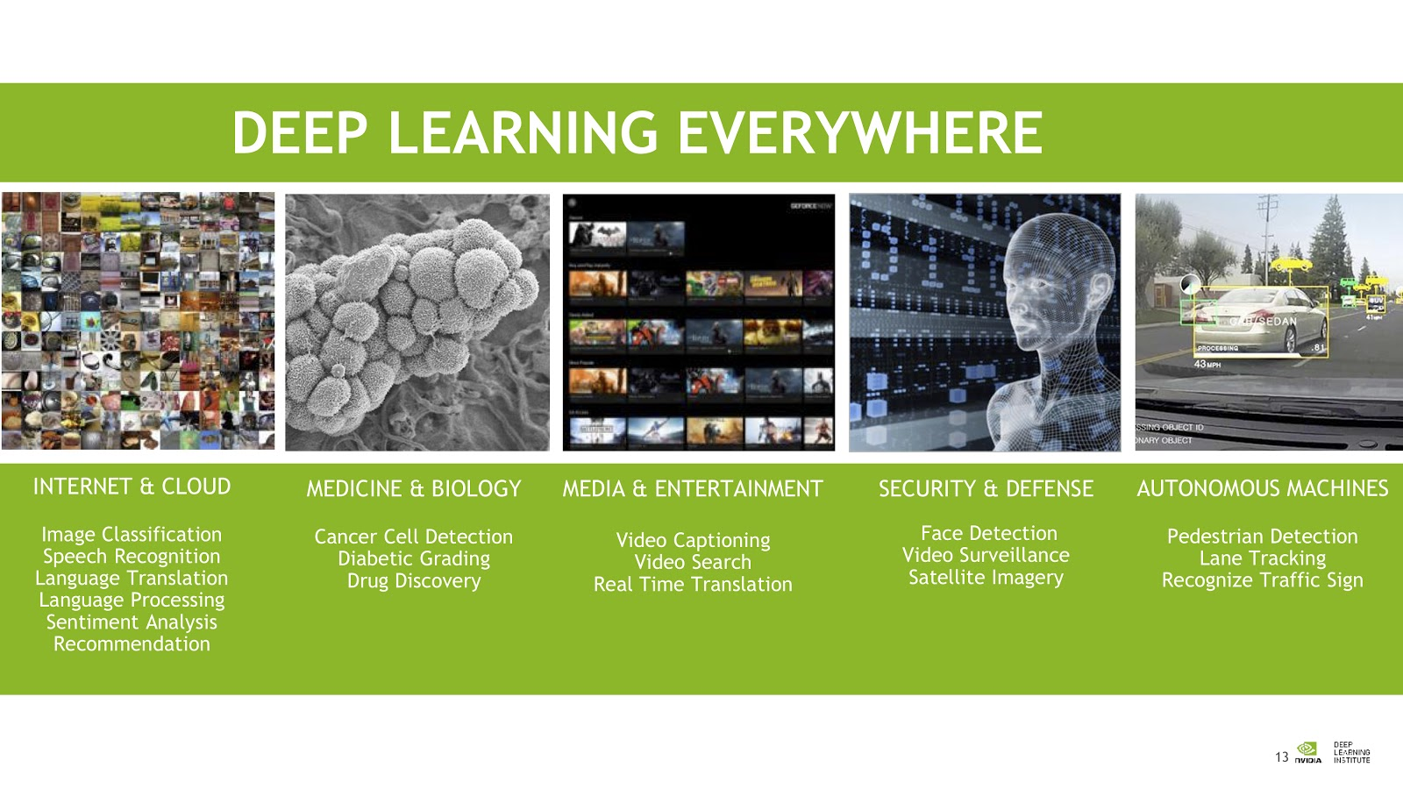
Deep learning is revolutionizing many aspects of our lives including medicine
Image source: Nvidia

Slide 5
Supervised deep learning for image classification
Image source: Google

Slide 6
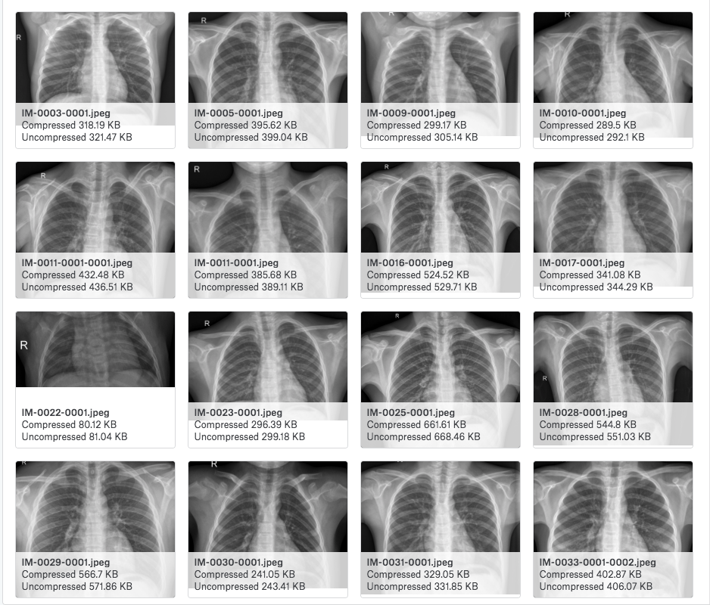
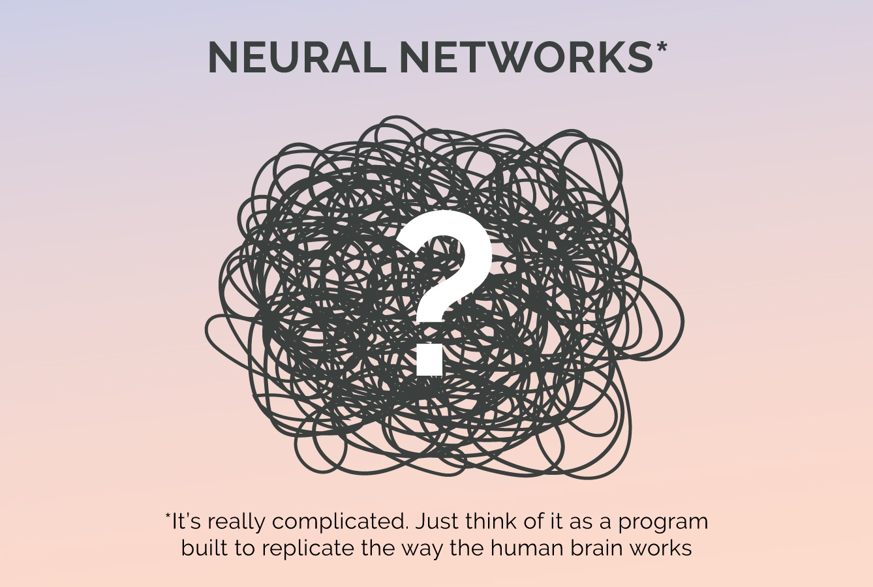
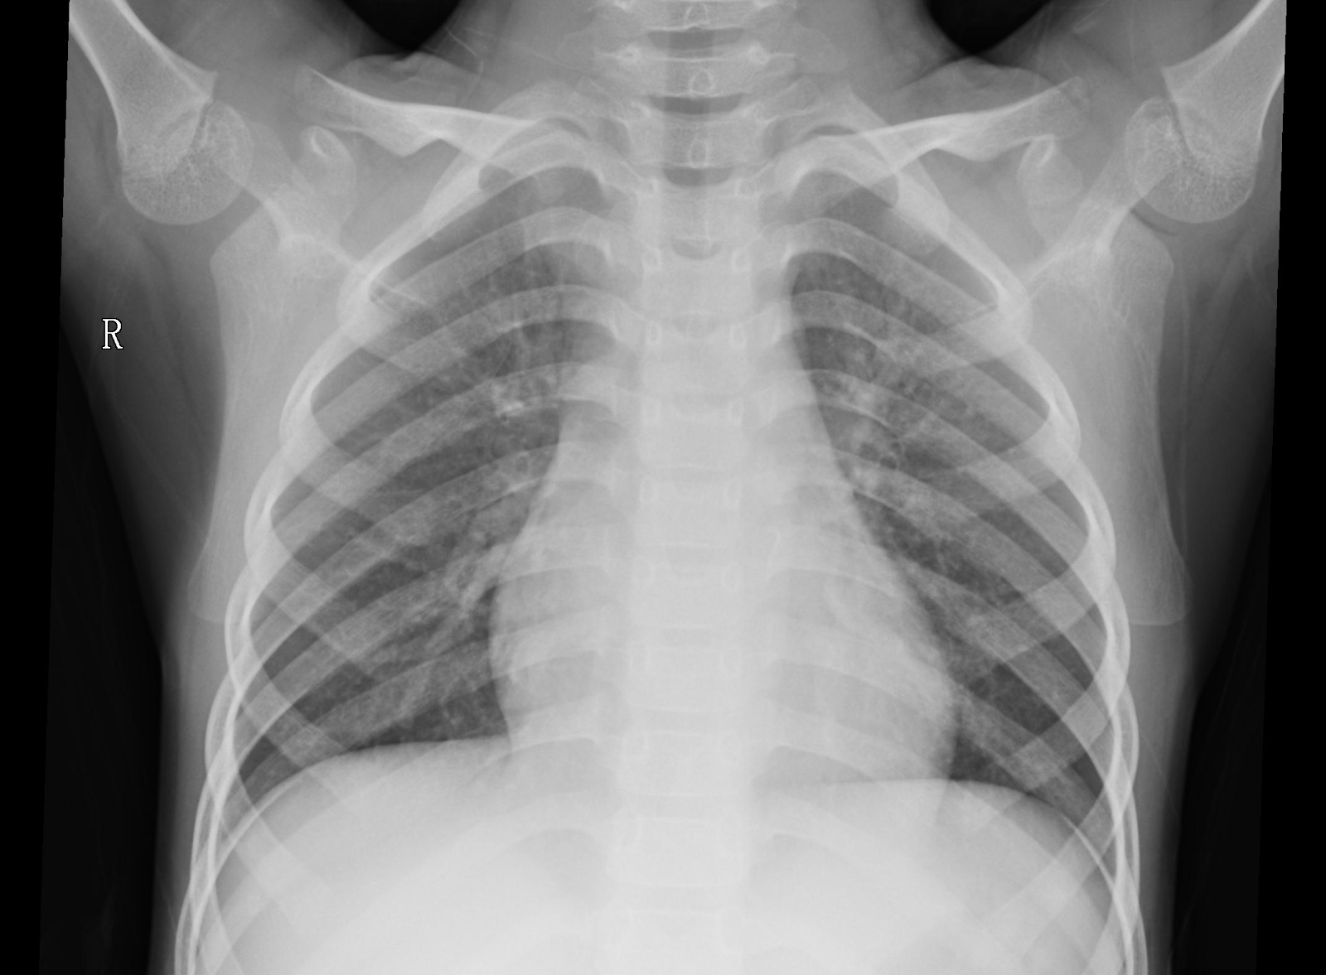
Detecting pneumonia using supervised deep learning
Chest X-Ray Images
Pneumonia?
Accuracy:
91%
Read more: medium.com/@yuan_tian

Slide 7
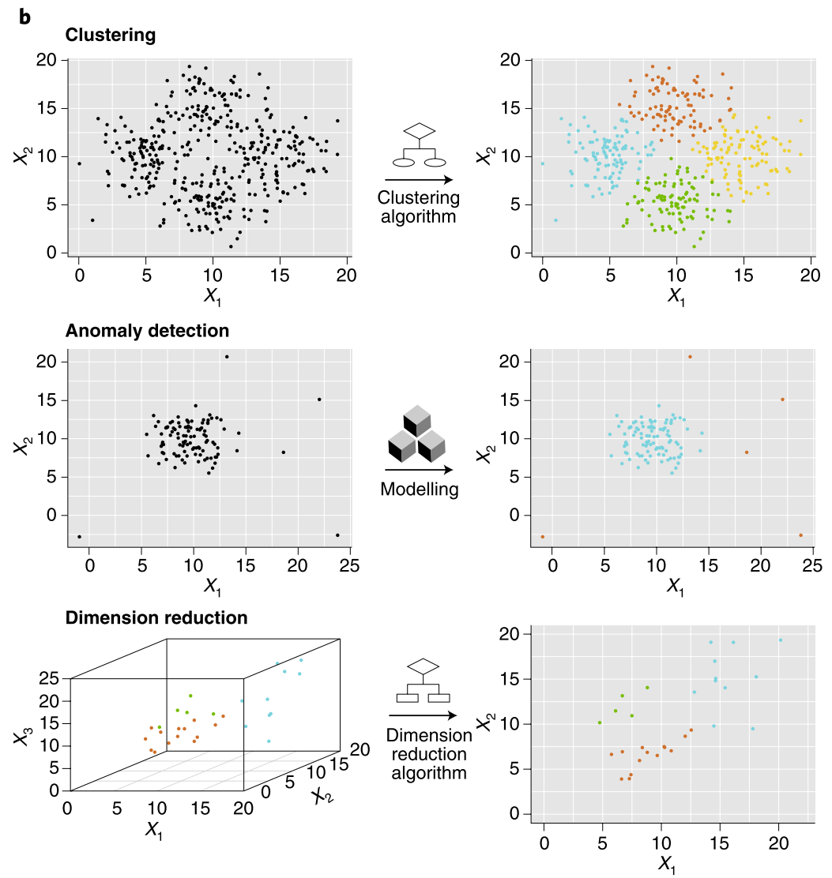
Unsupervised deep learning applications for biomedical data

Slide 8
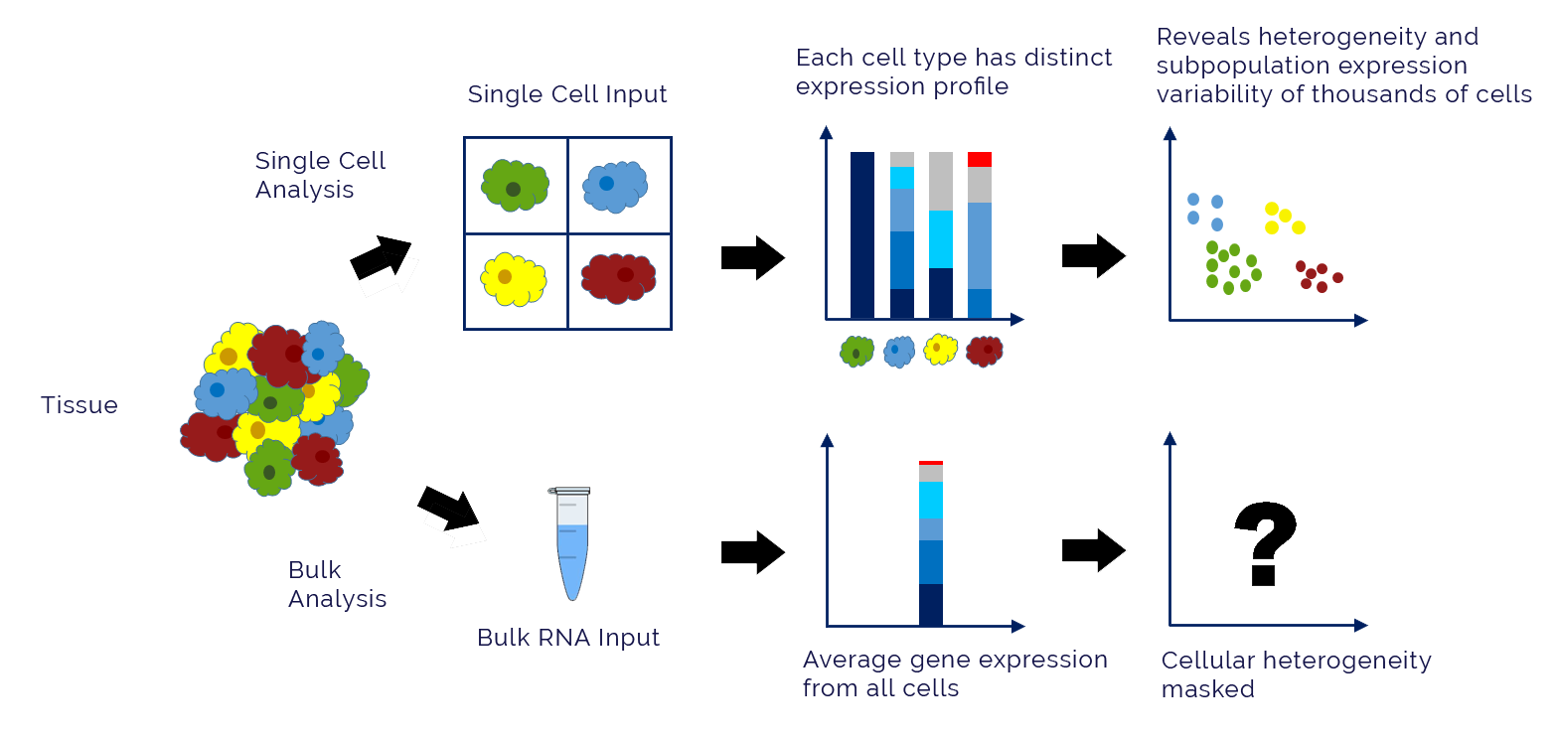
Single-cell sequencing reveals cellular heterogeneity that is masked by bulk sequencing methods
Image source: LC Sciences

Slide 9
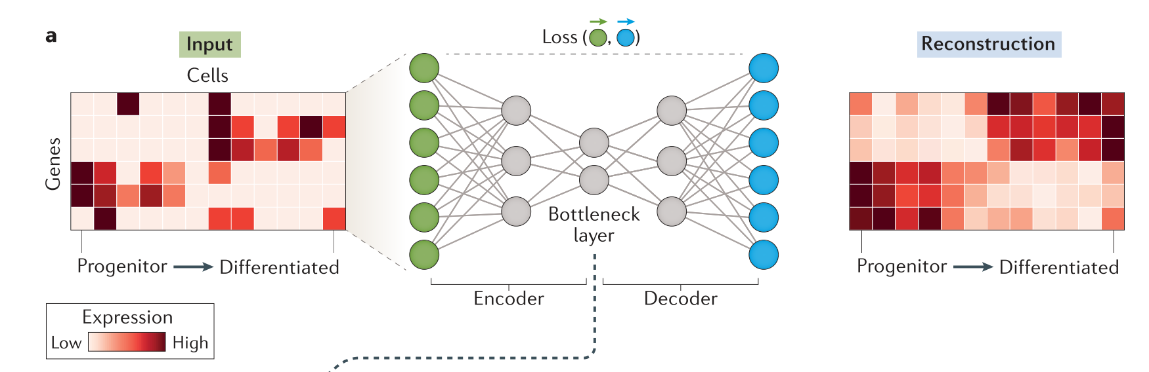
Use autoencoders for single-cell sequencing data
Dimensionality reduction, clustering…
Image source: Eraslan et al. Nat Rev Genet . 2019

Slide 10
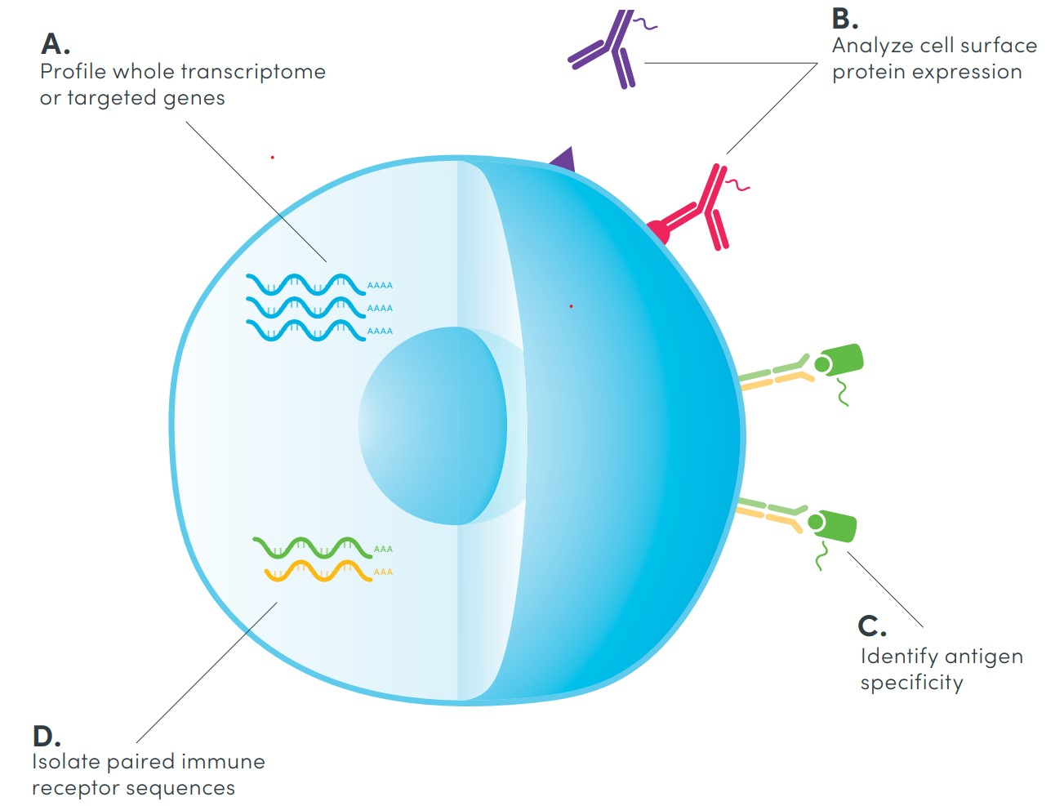
CITE-seq simultaneously measures gene expression and surface protein at a single-cell level
CITE-seq: Cellular Indexing of Transcriptomes and Epitopes by Sequencing
Image source: 10x Genomics

Slide 11
CITE-seq count matrices for RNA and proteins
 | Gene 1 | Gene 2 | … | Gene n
Cell 1 | 0 | 3 | . | 20
Cell 2 | 2 | 5 | . | 10
Cell 3 | . | . | . | .
… | . | . | . | .
Cell n | 10 | 2 | . | 1
 | Protein1 | Protein 2 | … | Protein n
Cell 1 | 30 | 2 | . | 12
Cell 2 | 1 | 3 | . | 4
Cell 3 | . | . | . | .
… | . | . | . | .
Cell n | 5 | 10 | . | 8

Slide 12
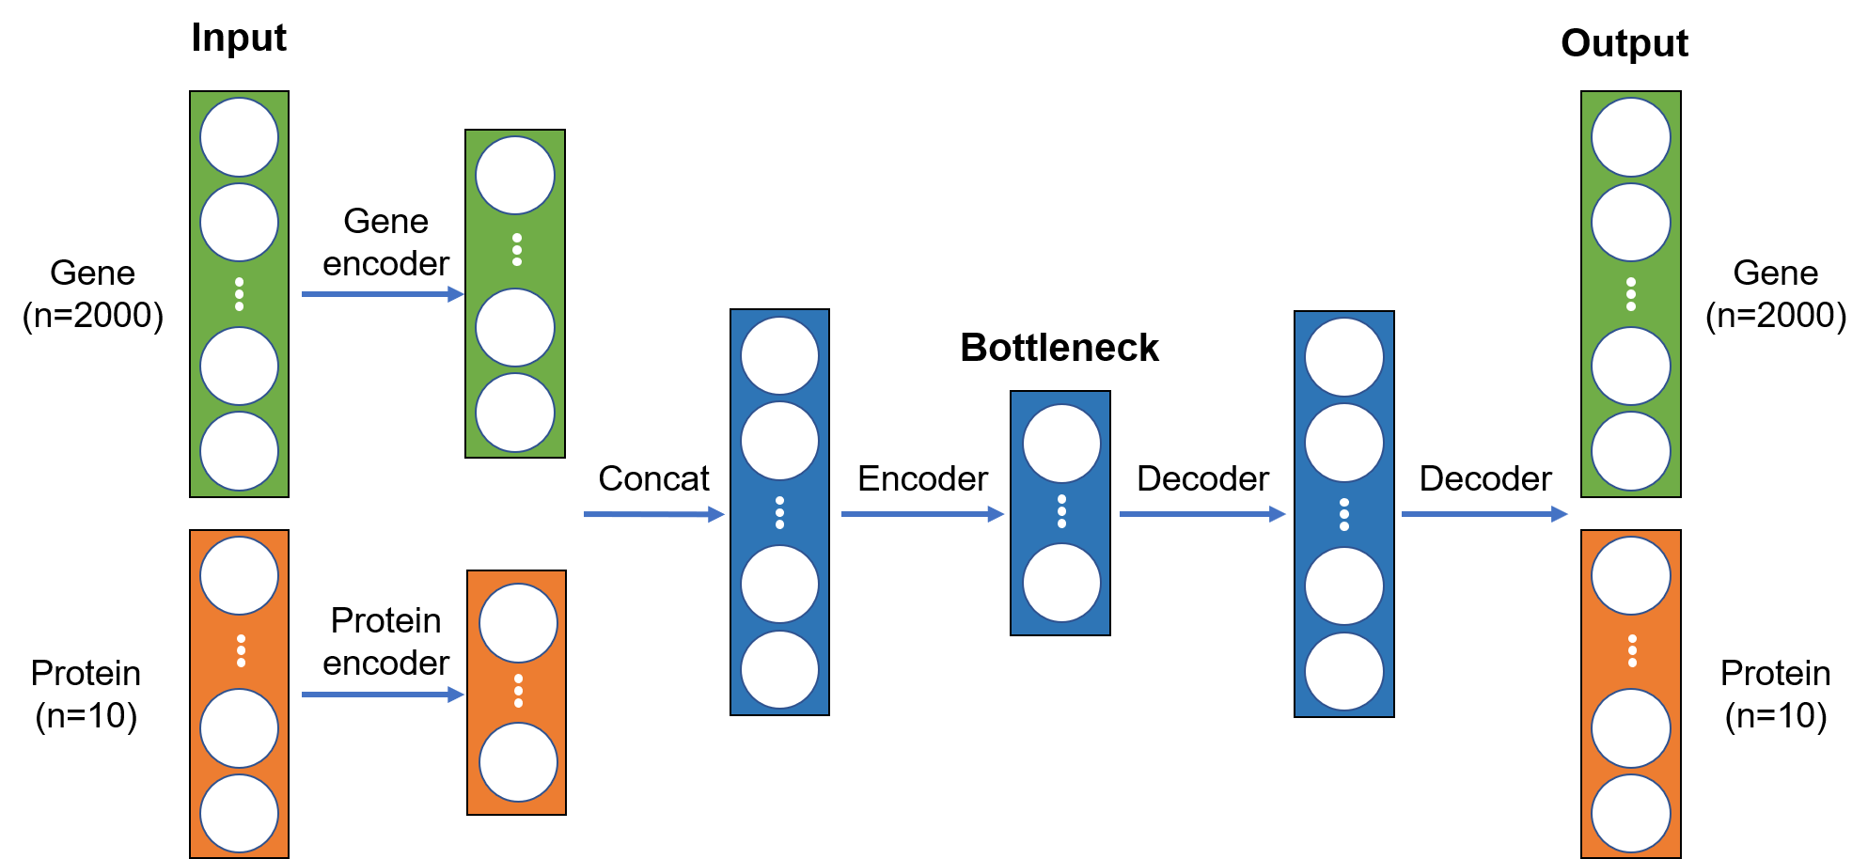
Autoencoder architecture for CITE-seq data

Slide 13
Implementation of a CITE-seq autoencoder using Pytorch
https://github.com/naity/citeseq_autoencoder

